Slide 1

Generation of System Tests through Transition Systems
Final Results – Felix Hausberger
Seminar: Better software through systematic tests Supervisor: Prof. Dr. Barbara Paech, M.Sc. Astrid Rohmann Heidelberg University
2021/01/18

Slide 2
Agenda
The Problem
Literature Research
Automatic Test Generation: A Use Case Driven Approach [1]
An Automatic Approach to System Testing based on Scenarios and Operations Contracts [2]
Comparison
Conclusion
Discussion

Slide 3
The Problem
Traceability problems between high-level use cases & concrete test case execution
Lack of integration of formal methods with well-established development life cycles
Shift effort of test generation to specification activity
Generate test scenarios from means of the specification area by traversing a transition system
The Problem | Literature Research | 1. Approach | 2. Approach | Comparison | Conclusion | Discussion
1/26
Notes:
Which requirements could be covered in which tests and therefore which requirements got implemented?
The process of formal denition of requirements and matching system tests must be brought closer together
To automatically derive test scenarios from means of the specication area transition systems are used.
They help to generate test paths through possible combinations of fine-grained functional requirements.
An equivalent approach can be used to derive robustness tests as well. In this process requirements can furthermore be tested on their consistency, correctness and integration and eventually can be refined further

Slide 4
Research Planning
Central Research Question
„Which approaches for automatic generation of system tests exist that are using contract enriched use cases or other use case related means of the specification area within a transition system simulation model?“
Search Terms:
System tests
Automatic generation
Transition system
Simulation model
Use cases
Contracts
The Problem | Literature Research | 1. Approach | 2. Approach | Comparison | Conclusion | Discussion
2/26
Notes:
Focus: finding a second approach to automatically generate system tests from means of the specification phase by exhaustively simulating a transition system to generate test paths similar to the first approach
But the first approach is restricted on using contract enriched use cases and use case scenarios, the way how test objectives are derived was this time freely selectable to receive another new, but similar approach

Slide 5
Research Planning
Research Sources: IEEE Xplore¹, ACM²
Relevance Criteria
Does the method described in the article generate system tests automatically from use cases or other use case related means of the specification area?
Are test objectives generated using some kind of simulation model based on use case contracts (pre- and postconditions) or similar transition system approaches?
¹https://ieeexplore.ieee.org/
²https://dl.acm.org/
The Problem | Literature Research | 1. Approach | 2. Approach | Comparison | Conclusion | Discussion
3/26
Notes:
Pre-search results were promising both on IEEE Xplore and ACM. Only some papers on ACM could not be accessed publicly. The amount of results should be sufficient to cover all relevant scientific papers.
As system tests can not exclusively be derived from means of the specification area, an article should restrict to generating system tests from use case related means of the specification area.
To derive test objectives a transition system should be simulated exhaustively based on contract definitions (pre- and postconditions).

Slide 6
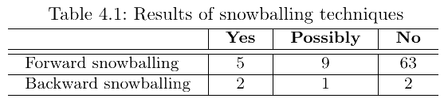
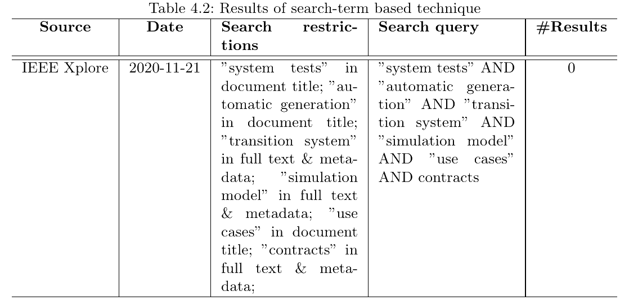
Research Execution and Evaluation
140 papers referencing [1]
46 papers referenced by [1]
The Problem | Literature Research | 1. Approach | 2. Approach | Comparison | Conclusion | Discussion
4/26
Notes:
The backward snowballing approach was restricted on references stated in the “Related Work” chapter as all other references relate to preceding work that serve as basic knowledge to realize the transition system approach in the first approach.
Additionally, most of the references were quite old since the original paper was published in 2006. Therefore not all papers could be found on IEEE Xplore or ACM.
Only papers published between 2006 and 2020 having the search term "test" and "use case" in their publication title were evaluated.
From the resulting papers, only one was considered suitable as a potential second paper.
Other papers were not chosen because of various reasons: No contract enriched use cases, no formal language to define use cases and contracts, only for testing of web applications and no system tests, not accessible

Slide 7
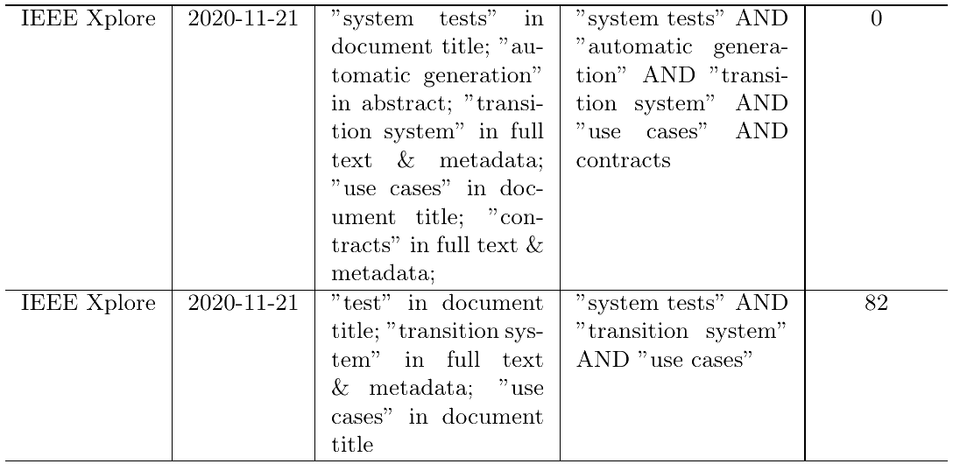
Research Execution and Evaluation
The Problem | Literature Research | 1. Approach | 2. Approach | Comparison | Conclusion | Discussion
5/26
Notes:
The backward snowballing approach was restricted on references stated in the “Related Work” chapter as all other references relate to preceding work that serve as basic knowledge to realize the transition system approach in the first approach.
Additionally, most of the references were quite old since the original paper was published in 2006. Therefore not all papers could be found on IEEE Xplore or ACM.
Only papers published between 2006 and 2020 having the search term "test" and "use case" in their publication title were evaluated.
From the resulting papers, only one was considered suitable as a potential second paper.
Other papers were not chosen because of various reasons: No contract enriched use cases, no formal language to define use cases and contracts, only for testing of web applications and no system tests, not accessible

Slide 8
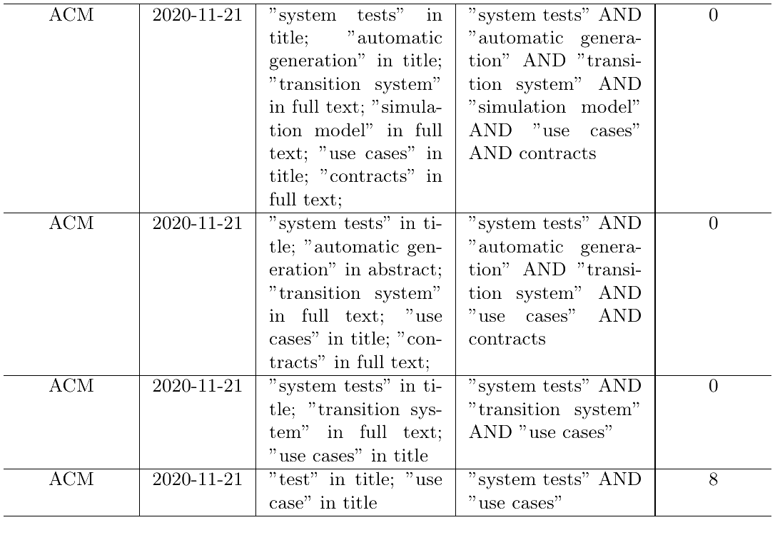
Research Execution and Evaluation
The Problem | Literature Research | 1. Approach | 2. Approach | Comparison | Conclusion | Discussion
6/26
Notes:
The backward snowballing approach was restricted on references stated in the “Related Work” chapter as all other references relate to preceding work that serve as basic knowledge to realize the transition system approach in the first approach.
Additionally, most of the references were quite old since the original paper was published in 2006. Therefore not all papers could be found on IEEE Xplore or ACM.
Only papers published between 2006 and 2020 having the search term "test" and "use case" in their publication title were evaluated.
From the resulting papers, only one was considered suitable as a potential second paper.
Other papers were not chosen because of various reasons: No contract enriched use cases, no formal language to define use cases and contracts, only for testing of web applications and no system tests, not accessible

Slide 9
Automatic Test Generation: A Use Case Driven Approach
Use cases and contracts
Simulation model (UCTS)
Interpreter
Simulator
Improving requirements via simulation and model checking
Requirements
Test objective generator (UCSystem)
Use cases scenarios
Test scenarios generator
(UC-SCSystem)
Test objectives
[1]
Manual phase
Set of test scenarios
Semi-automated phase
Automated phase
The Problem | Literature Research | 1. Approach | 2. Approach | Comparison | Conclusion | Discussion
7/26
Notes:
Formalization of the requirements based on UML use cases enhanced with contracts (pre- & postconditions)
No ambiguities anymore
Made executable by writing them in the form of requirement-level logical expressions
Contracts used to infer the correct partial ordering of functionalities that the system should offer
Dedicated editor
Simulation model (Use Case Transition System)
Checks for correctness & consistency
Build model of all valid sequences of use cases
Extract relevant paths / „test objectives“ with coverage criteria
Generate test scenarios from test objectives
Replace each use case with a sequence diagram (use case scenario) that is compatible in terms of static contract matching using UC-SCSystem
Specify the exchange of messages involved between the environment and the system
Evaluation by using statement coverage
Tested at Thalès Airbourne Systems (TAS)

Slide 10
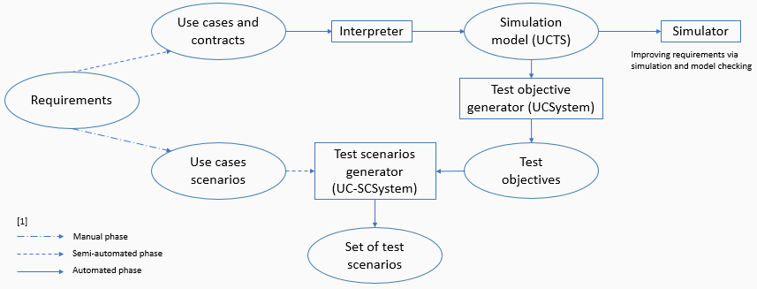
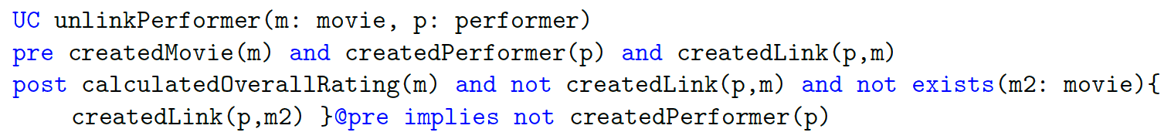
Automatic Test Generation: A Use Case Driven Approach
Phase I
Use cases ≈ “Main functions of the system”
Contracts: Specify system properties to make use cases applicable (preconditions) and system properties acquired by the system after the application of a use case (postconditions)
The Problem | Literature Research | 1. Approach | 2. Approach | Comparison | Conclusion | Discussion
8/26
Notes:
Goal of this phase: generate test objectives
Contracts
Made executable by writing them in the form of requirement-level first-order logical expressions (predicates with logical expressions)
Used to describe facts in the system (on actors state, main concept states, roles, …)
Conditions always evaluate to true or false, never to undefined
Logical operators, quantifiers, implications
Parameters: actors and main concepts of the UC
Used to infer the correct partial ordering of functionalities that the system should offer
Limitations of the contracualized UC Model:
Deriving and maintaining a nonredundant, minimal set of contracts and predicates (Be precise and rigorous in the semantics given)
=>Editor tool to manage the predicates and guide the design of contracts
Handle complex data types
Deterministic postconditions

Slide 11
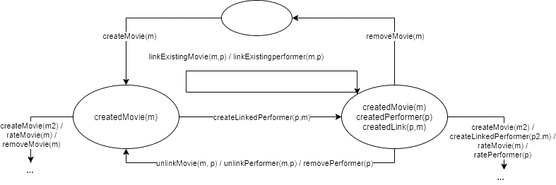
Automatic Test Generation: A Use Case Driven Approach
Phase I
UCSystem: Prototype/Interpreter-Tool
Builds the use case transition system UCTS (simulation model)
Generates correct sequences of use cases, i.e. “test objectives”
The Problem | Literature Research | 1. Approach | 2. Approach | Comparison | Conclusion | Discussion
9/26
Notes:
Simulation phase: check & possibly correct the requirements before the tests are generated
=> Identify inconsistencies between predicates and contracts
=> Identify underspecification or errors in the requirements, verify invariants
Simulating the use cases:
Instantiated use cases: Replace set of formal parameters with all the possible combinations of their possible actual values (actors + main concepts)
Simulation state: set of instantiated predicates, that evaluate to true
Apply an instantiated use case: simulation state and precondition must match, update simulation state according to postcondition

Slide 12
Automatic Test Generation: A Use Case Driven Approach
Phase I
Generate test objectives from UCTS with regard to a given coverage criteria:
All Edges criterion (AE)
All Vertices criterion (AV)
All Instantiated Use Cases criterion (AIUC)
All Vertices and All Instantiated Use Cases criterion (AV-AIUC)
All Precondition Terms criterion (APT)
Robustness criterion
All algorithms are based on breadth-first search in the UCTS
The Problem | Literature Research | 1. Approach | 2. Approach | Comparison | Conclusion | Discussion
10/26
Notes:
APT: all possible ways to apply a use case are exercised
Robustness criterion: exercise a use case in as many different ways as possible to make ist precondition false
Breadth-first search: obtain small test-objectives: human-understandable and meaningful

Slide 13
Automatic Test Generation: A Use Case Driven Approach
Phase II
UC-SCSystem:
Replace each use case of the test objectives by one of its use case scenarios
Generates test cases (JUnit) and runs them
The Problem | Literature Research | 1. Approach | 2. Approach | Comparison | Conclusion | Discussion
11/26
Notes:
Goal of this phase: Generate test scenarios

Slide 14
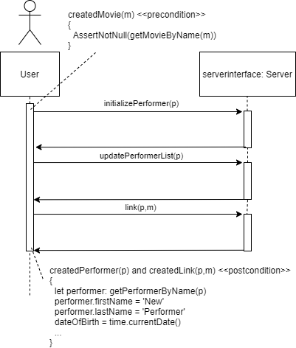
Automatic Test Generation: A Use Case Driven Approach
Phase II
Use case scenario contains the main messages exchanged between the tester and the SUT
Says how the system has to be simulated to perform a use case and how to react to the simulation
Contains more detailed pre- & postconditions
Contracts which rely on the rest of the model -> OCL
Contracts which rely on the predicates of UCs -> Formal language
Use case scenarios are system-level
The Problem | Literature Research | 1. Approach | 2. Approach | Comparison | Conclusion | Discussion
12/26
Notes:
Use case scenario = Sequence diagram
Each use case scenario belongs to a use case: has the same parameters, either nominal or exceptional (functional vs. robust)
Each use case scenario => executable test case => test scenario (+ parameters & messages)
Attributes: instances the tester wants to deal with, to be completed by the tester
Each use case scenario has one method in the ScenarioPool (i.e. one test case)
Insert actual parameters to calls in the ScenarioPool
OCL contracts are transformed into JUnit assertions, the exchange of messages into Java calls

Slide 15
Automatic Test Generation: A Use Case Driven Approach
Challenges
Simulation model has to be compact enough to avoid combinatorial explosion of the internal states
maxsize_{UCTS} = 2^{Nip} with N_{ip} = p * (max_{instances})^{maxparam}
Two-phase approach (high-level vs. low-level requirements)
Use case parameters: main system concepts + actors
Test generation criteria
Automate the production of test objectives
Most efficient ones identified experimentally
The Problem | Literature Research | 1. Approach | 2. Approach | Comparison | Conclusion | Discussion
13/26
Notes:
In practise many of the potential states are not reachable
Only a small number of instances are necessary for achieving statement coverage

Slide 16
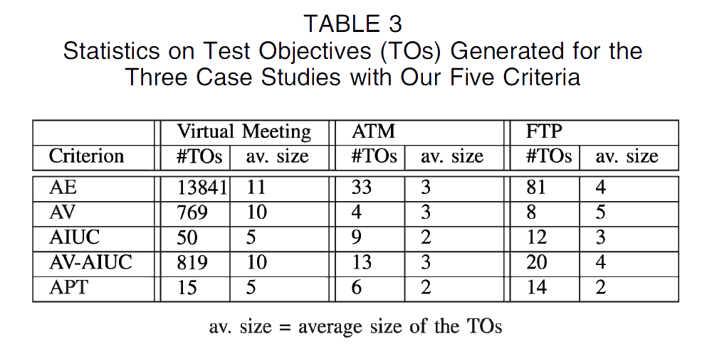
Automatic Test Generation: A Use Case Driven Approach
Evaluation
The Problem | Literature Research | 1. Approach | 2. Approach | Comparison | Conclusion | Discussion
14/26
Notes:
All scenarios strategy: Every use case scenario has to be executed by at least one test case
Fail verdict: post condition violated
Pass verdict
Inconclusive verdict: precondition violated
Non-executed test scenarios
Because of underspecification or because of test data
Evaluation:
3 software programs (Automated Teller Machine, FTP Server and Virtual Meeting Server)

Slide 17
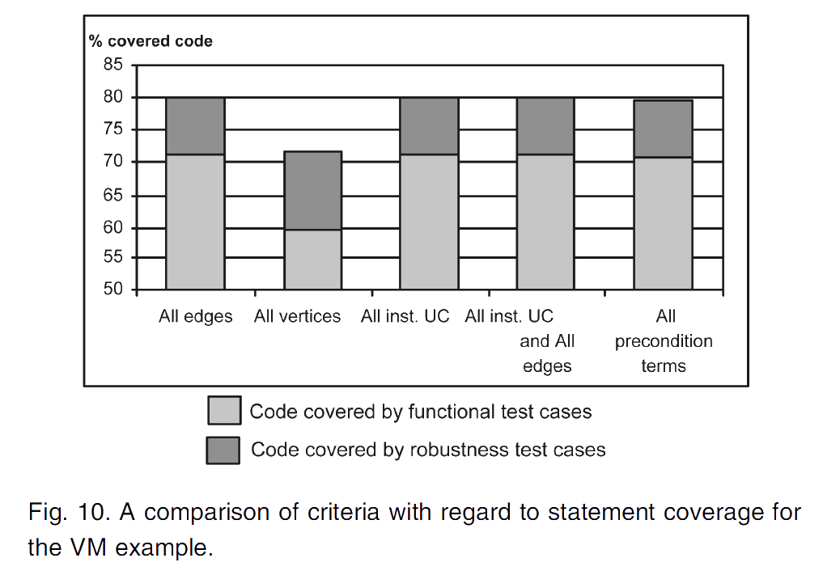
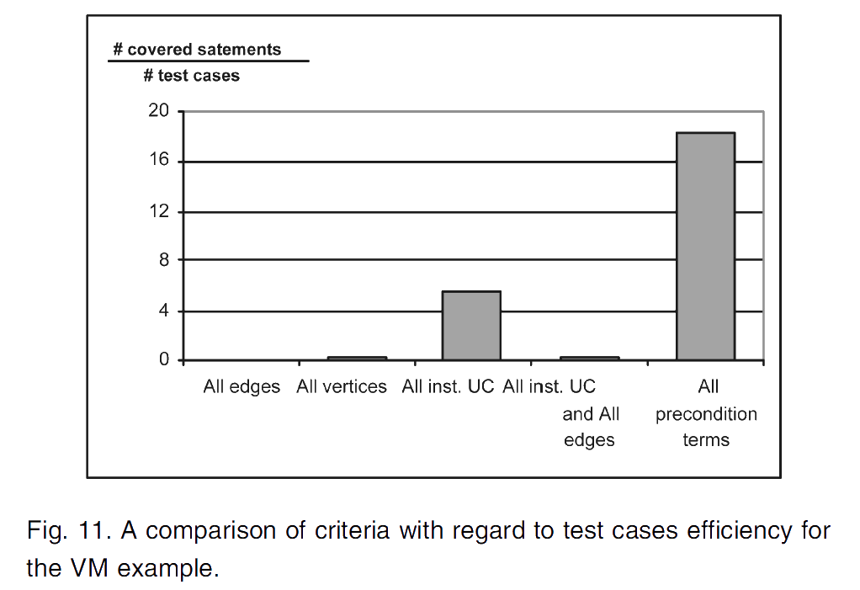
Automatic Test Generation: A Use Case Driven Approach
Evaluation
The Problem | Literature Research | 1. Approach | 2. Approach | Comparison | Conclusion | Discussion
15/26
Notes:
Evaluation:
> 70% code coverage, with robustness > 80%
AV criterion low, because not all use cases covered (those, who do not change the system state)
Rest equal code coverage, but not in efficiency
AE, AV, AV-AIUC: low efficiency

Slide 18
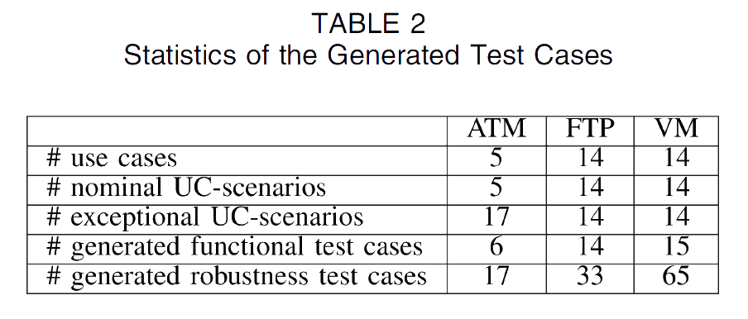
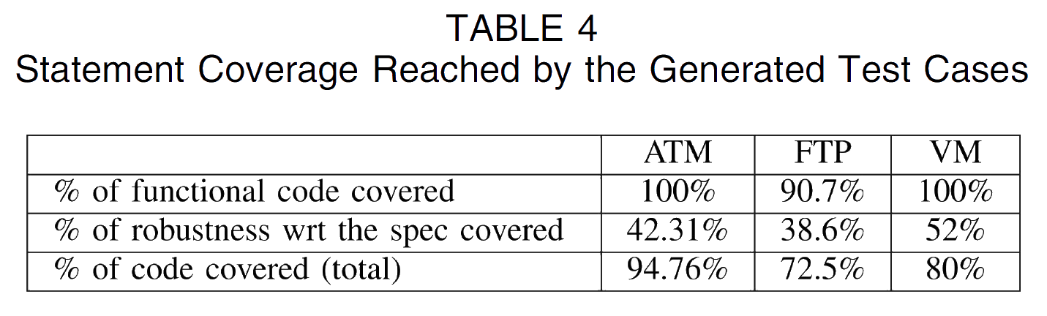
Automatic Test Generation: A Use Case Driven Approach
Evaluation
The Problem | Literature Research | 1. Approach | 2. Approach | Comparison | Conclusion | Discussion
16/26
Notes:
Evaluation:
APT: 15 test cases -> 100% functional code coverage
Robustness criterion bad: high #TX -> Low efficiency (65 -> 52%)
Approach is good for functional code, bad for robustness code
Only violates preconditions of UCS
Take test data more into account
Violate preconditions of use case scenarios as well
Extension: Activity diagrams to model use case dependencies, not contracts!

Slide 19
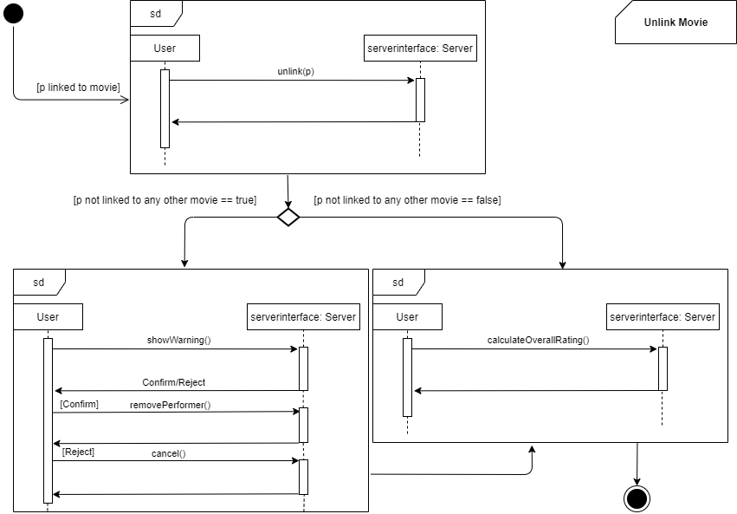
An Automated Approach to System Testing based on Scenarios and Operations Contracts
Uses scenarios expressed as UML interaction overview diagram (IOD)
The Problem | Literature Research | 1. Approach | 2. Approach | Comparison | Conclusion | Discussion
17/26
Notes:
Interaction overview diagram (IOD): special form of activity diagram used to show control flow of a use case
Nodes: interaction diagram (sequence diagrams) or interaction occurences that show an operation invocation
Corresponds to a use case
Used for automated generation of test paths for system testing

Slide 20
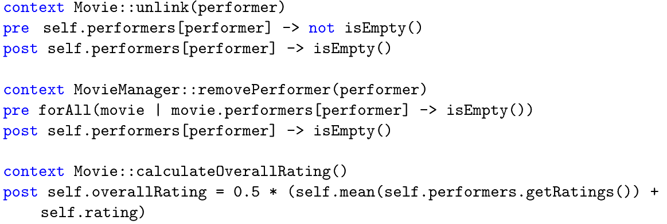
An Automated Approach to System Testing based on Scenarios and Operations Contracts
Contract Transition System (CTS) is built by enhancing the operations in the IOD with contracts written in Object Constraint Language (OCL)
The Problem | Literature Research | 1. Approach | 2. Approach | Comparison | Conclusion | Discussion
18/26
Notes:
CTS models all scenarios of an IOD

Slide 21
An Automated Approach to System Testing based on Scenarios and Operations Contracts
Input:
XML Metadata Interchange (XMI) file for the IOD generated
Operation contracts in Object Constraint Language (OCL)
List of operations retrieved from XMI file
States are created against each precondition and each postcondition of a contract for an operation
Transitions are provided by the operations (nodes) in the IOD
Contract Transition System
The Problem | Literature Research | 1. Approach | 2. Approach | Comparison | Conclusion | Discussion
19/26
Notes:
Initial state: true
Logical if-then-else conditions are resolved by combining their testing condition with the result
Two different sub-states created
Post-condition: composition of the two sub states
If contracts statements are the same for different operations
Split the identical statements into two sub states
Eliminate join nodes
Additional transitions are added for all conditional flows leading to alternative scenarios and their guard conditions are attached to them

Slide 22
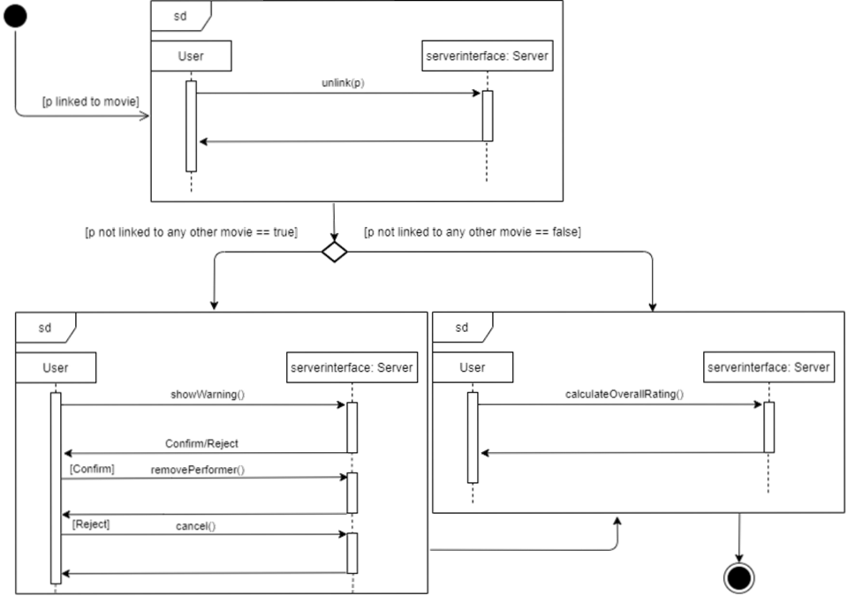
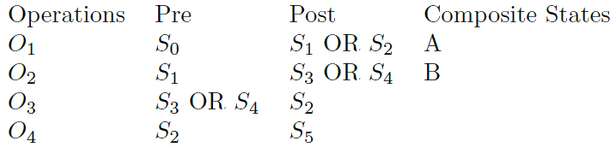
An Automated Approach to System Testing based on Scenarios and Operations Contracts
The Problem | Literature Research | 1. Approach | 2. Approach | Comparison | Conclusion | Discussion
20/26

Slide 23
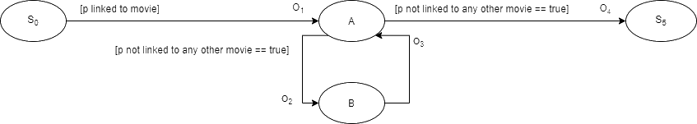
An Automated Approach to System Testing based on Scenarios and Operations Contracts
The Problem | Literature Research | 1. Approach | 2. Approach | Comparison | Conclusion | Discussion
21/26
Notes:
Additional CTS flows help to further refine the requirements
Find potential unwanted behavior or underspecification

Slide 24
An Automated Approach to System Testing based on Scenarios and Operations Contracts
Test paths are derived by path traversals from the inital node to the final node and by taking into account a specific coverage criterion
Transition coverage
State coverage
Transition pair coverage
Evaluation
State coverage criterion: all success scenarios get captured
Transition coverage criterion: reasonable #test paths, but not suitable for fault detection every time
Transition pair coverage criterion guarantees maximum fault detection
The Problem | Literature Research | 1. Approach | 2. Approach | Comparison | Conclusion | Discussion
22/26
Notes:
Transition coverage: 13
State coverage: 1 (covered by transition coverage)
Transition pair coverage: 26 (most expensive)
Transition coverage: guarantees coverage of all alternative flows in IOD

Slide 25
Comparison
Similarities
Transition system as a core component
Contracts used to define states in the transition system
Coverage criteria used to generate a certain amount of test cases
Requirement engineers can validate their specified requirements during the simulation of the transition system
Similar conclusions: core approach is helpful to generate functional test case scenarios for the requirements, nevertheless there is a lack to achieve a comparable coverage for robustness code for fault detection
The Problem | Literature Research | 1. Approach | 2. Approach | Comparison | Conclusion | Discussion
23/26
Notes:
AE / transition coverage criterion and AV / state coverage criterion in common
Brings testing and requirement engineering process closer together

Slide 26
Comparison
Differences
 | Automatic Test Generation: A Use Case Driven Approach | An Automated Approach to System Testing based on Scenarios and Operations Contracts
Field of application | Uses use cases to automatically generate system level tests | Restricts to generate test paths for a specific use case (use case scenarios already given in the IOD)
Input parameters | Requirement-level first order logical expressions (formal language) | Interaction Overview Diagram (graphical approach)
Extent | Almost fully automized end-to-end test scenario generation process | Focuses on test path generation only
The Problem | Literature Research | 1. Approach | 2. Approach | Comparison | Conclusion | Discussion
24/26

Slide 27
Conclusion
Both papers demonstrate how to start testing in early stages of development and how to eliminate traceability problems between requirement specification and concrete test case execution
Using only means of the specification level (use cases, contracts, use case scenarios and UML Interaction Overview Diagrams) one can automatically generate test cases using a transition system
Requirements can easily be validated on their consistency, correctness and on possible underspecification
Weakness: capability to generate a sufficient amount of robustness tests for fault detection
Both approaches show industry-standard and highly applicable solutions for the automatic generation of functional test scenarios
The Problem | Literature Research | 1. Approach | 2. Approach | Comparison | Conclusion | Discussion
25/26
Notes:
Both approaches only rely on contract violations and do not sufficiently cover data variations as test path generation is only based on one initial state chosen by the test creator.

Slide 28
Generation of System Tests through Transition Systems
Thank you for your attention
Seminar: Better software through systematic tests Supervisor: Prof. Dr. Barbara Paech, M.Sc. Astrid Rohmann Heidelberg University
2021/01/18

Slide 29

Discussion
The Problem | Literature Research | 1. Approach | 2. Approach | Comparison | Conclusion | Discussion
26/26

Slide 30
Sources
[1] Clémentine Nebut, Franck Fleurey, Yves Le Traon, Jean-Marc Jézéquel, Automatic Test Generation: A Use Case Driven Approach, 2006. [Online]. Available: https://ieeexplore.ieee.org/document/1610607 (visited on 11/25/2020)
[2] Najla Raza, Aamer Nadeem, Muhammad Zohaib Z. Iqbal, An Automated Approach to System testing based on Scenarios and Operations Contracts, 2007. [Online]. Available: https://ieeexplore.ieee.org/document/4385504 (visited on 11/25/2020)

